Slide 1
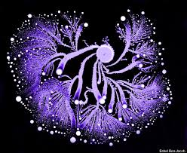
Stephanie Mathews
Environmental Microbiology
Department of Biological Sciences

Slide 3
https://www.youtube.com/watch?v=plVk4NVIUh8

Slide 4
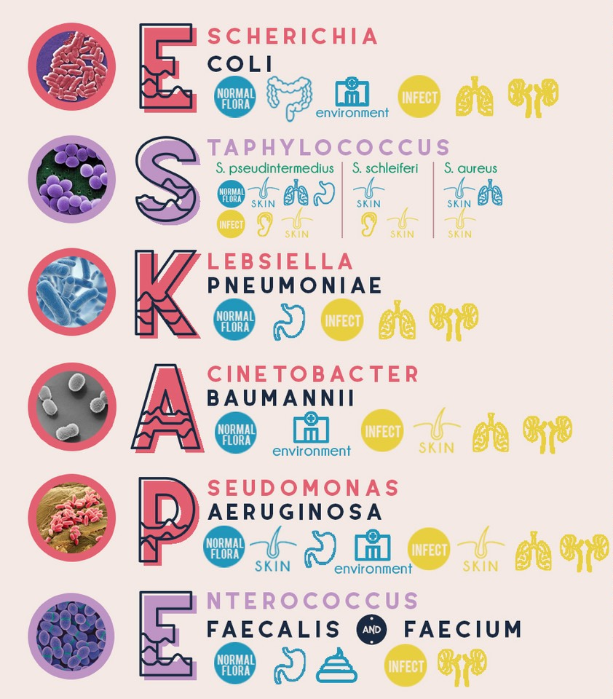
Nearly 2 million Americans per year develop hospital-acquired infections (HAIs), resulting in 99,000 deaths – the vast majority of which are due to antibacterial-resistant pathogens.

Slide 5
Research Questions
What environment may contain antibiotic producing bacteria?
Can we isolate antibiotic producing bacteria that can inhibit growth of hard-to-treat pathogens?

Slide 6
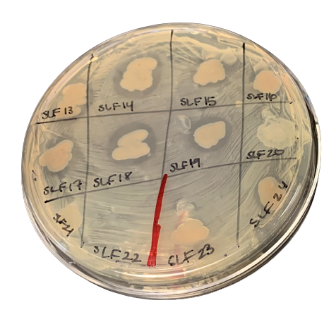
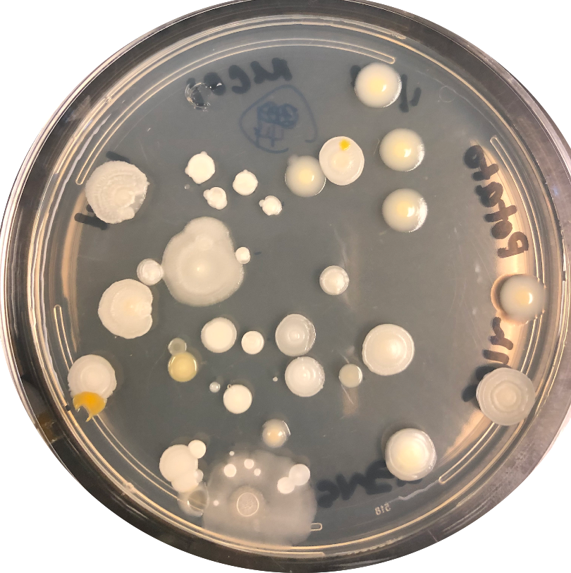
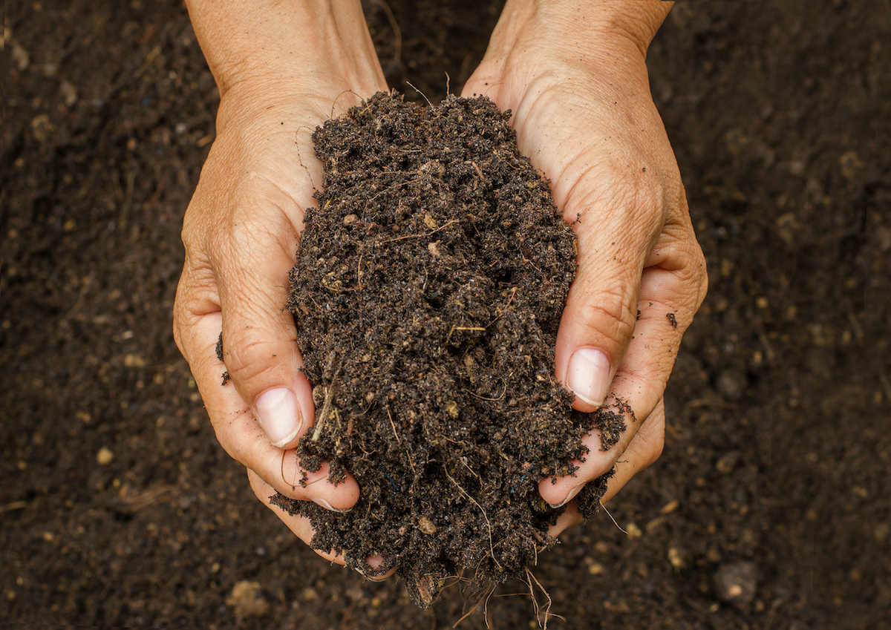
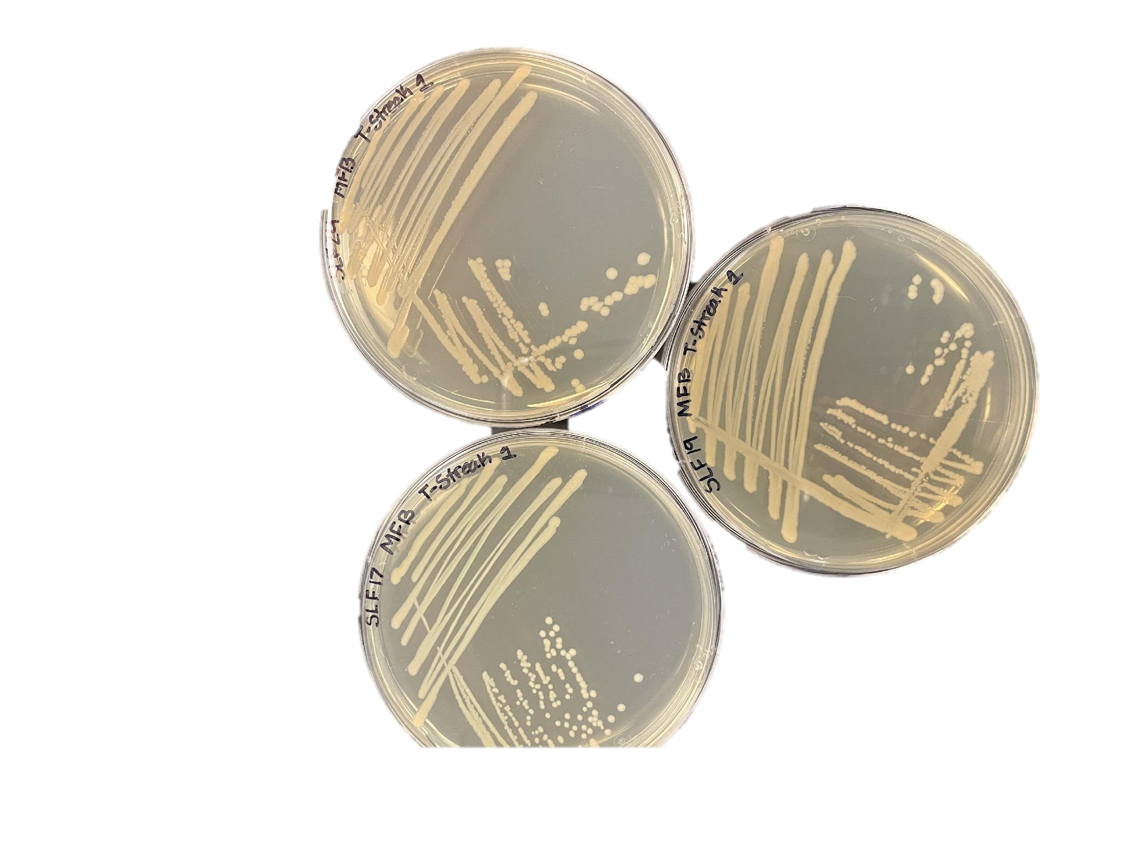
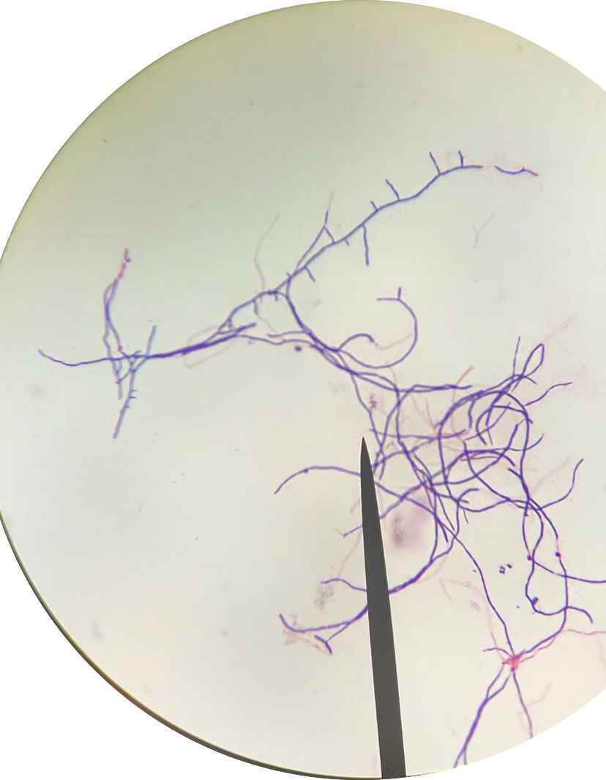
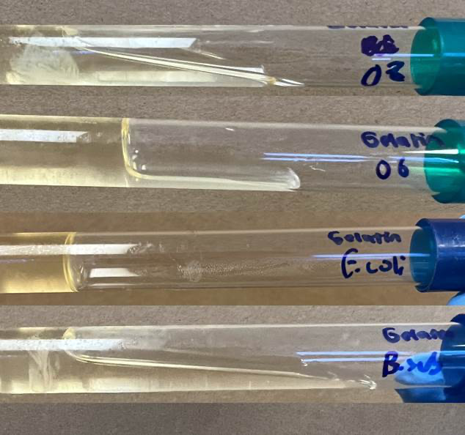
Methods

Slide 7
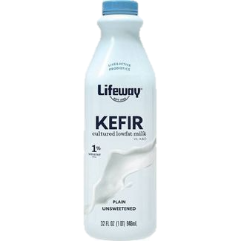
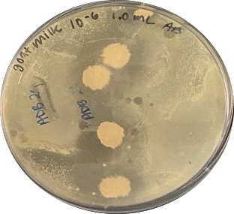
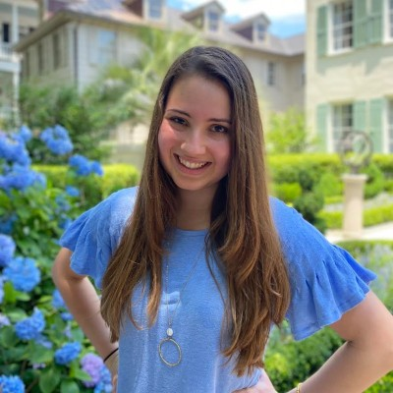
Antibiotic Producing Bacteria from Kefir Anna Braaten

Slide 8
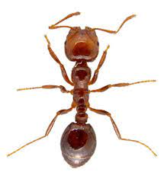
Antibiotic Producing Bacteria from Ants Leeann Stearns

Slide 9
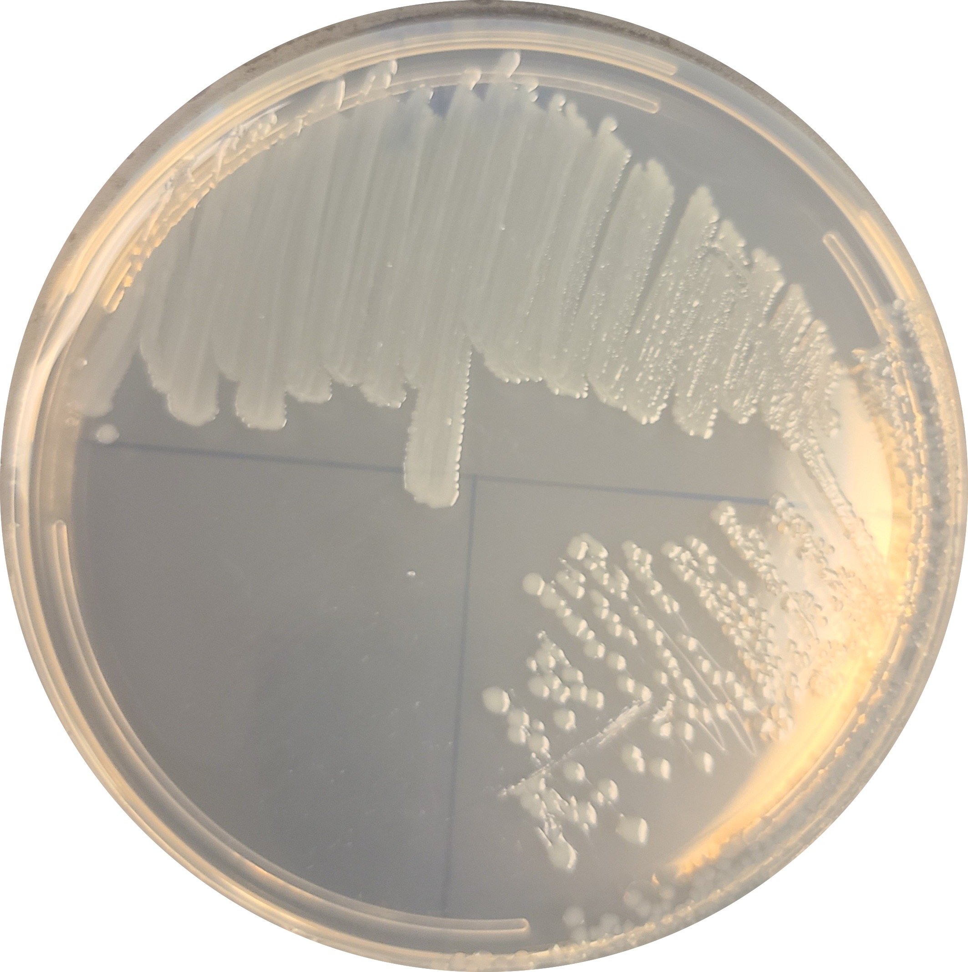
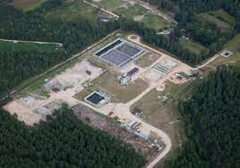
Antibiotic Producing Bacteria from Wastewater Thomas Rush

Slide 10
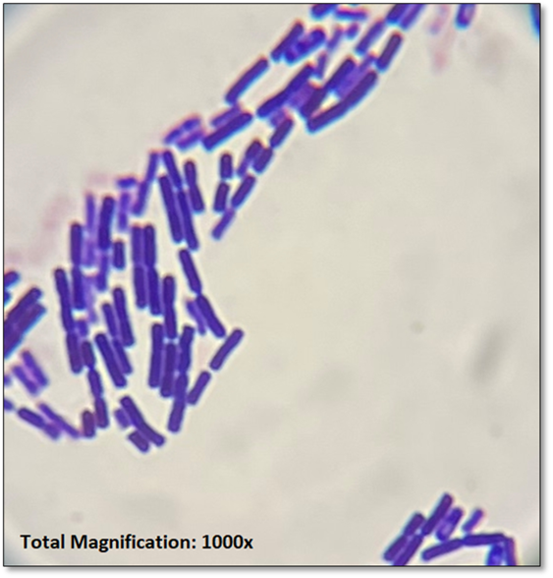
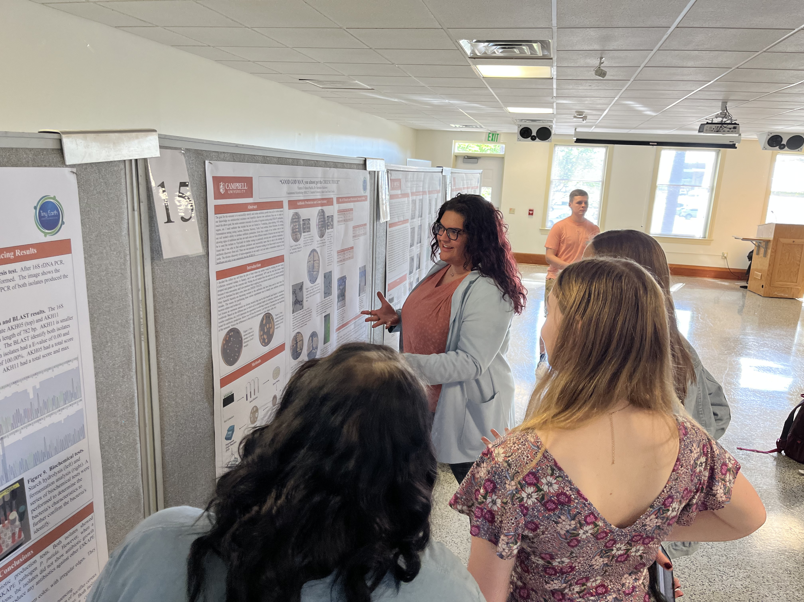
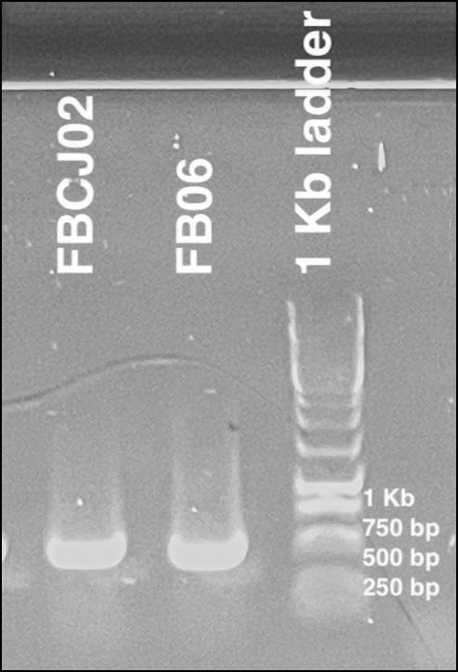
Antibiotic Producing Bacteria from Soil Biology 275 and 334 course labs
FB-CJ02: Bacillus cereus

Slide 11
Additional Research Questions
Is there diversity of heterotrophic nitrifying bacteria?
What roles does stress play in Women’s Lacrosse Athlete wellness?

Slide 12
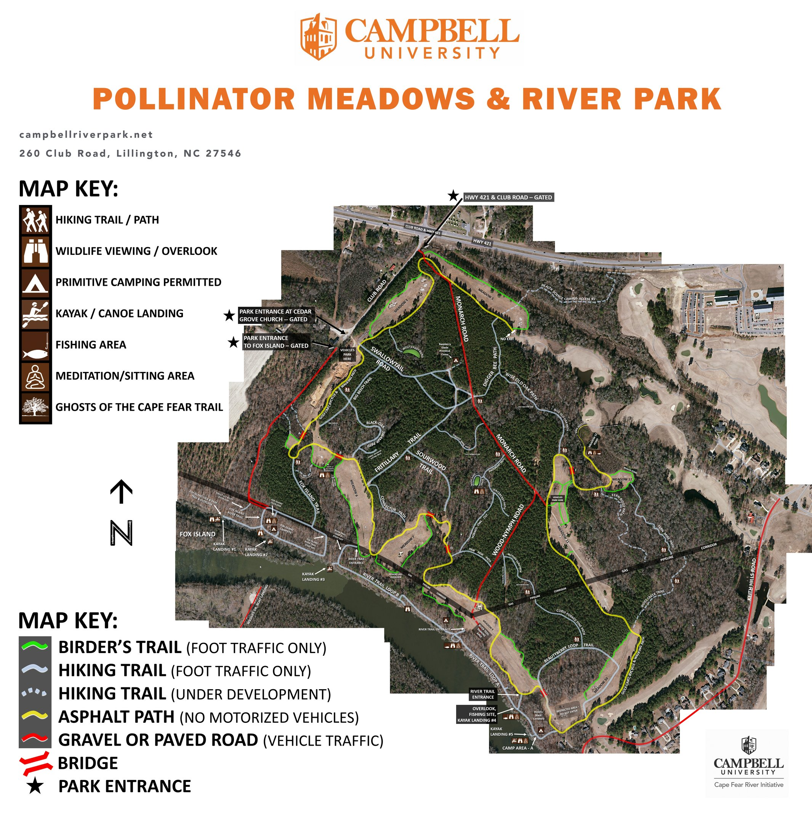
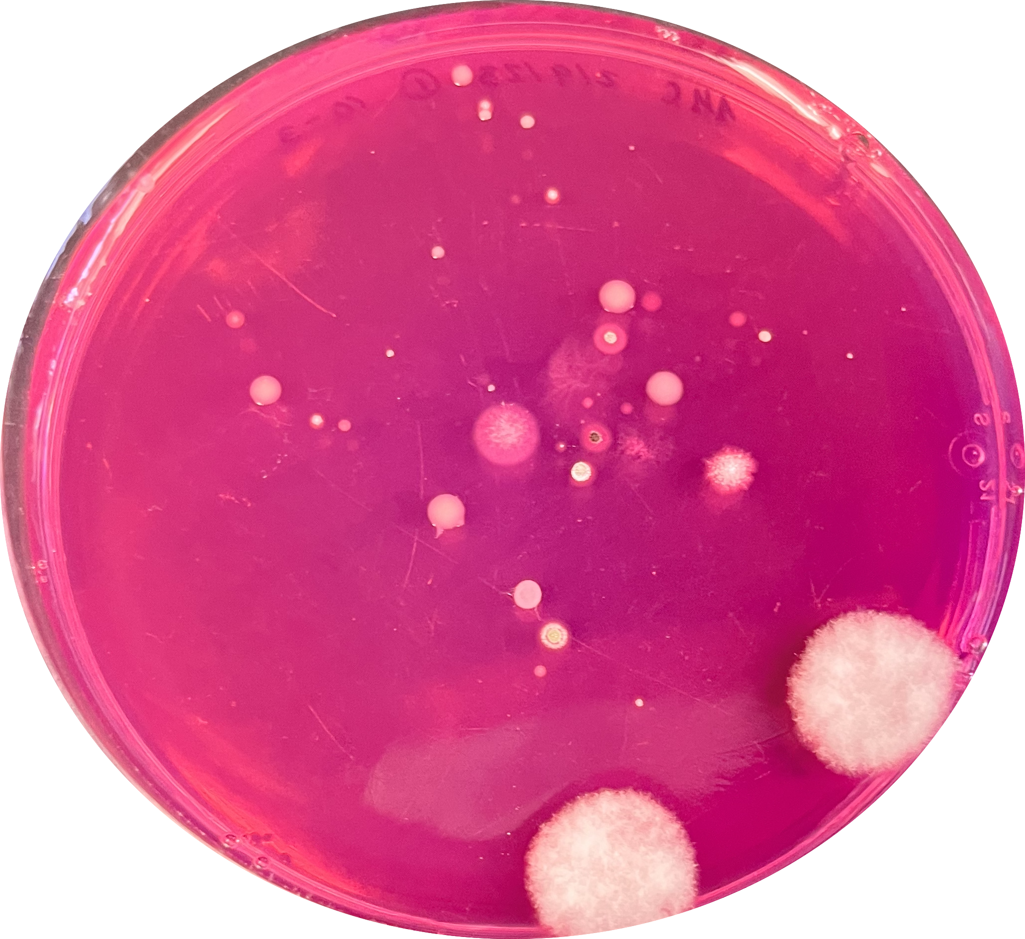
Isolation of Denitrifying Bacteria Allison Cannady

Slide 13
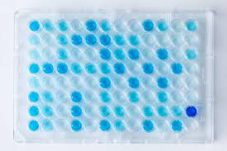
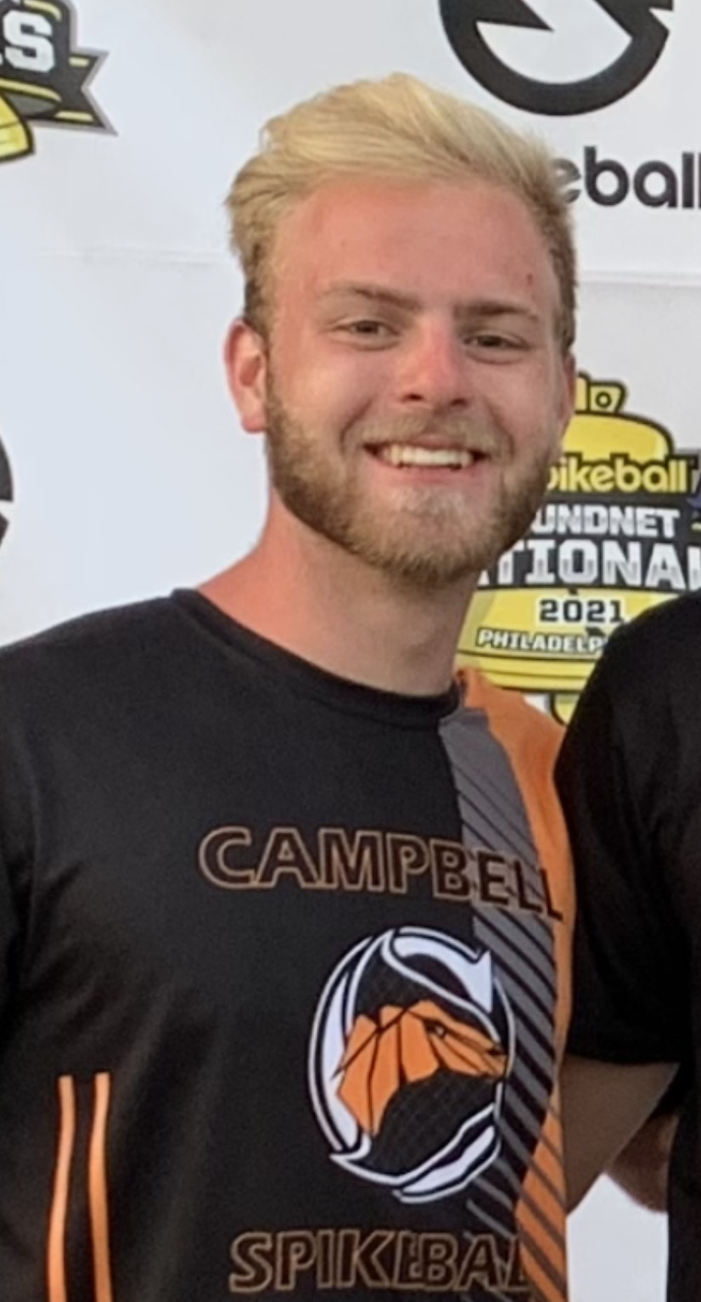
Cortisol and CRP analysis in CU athletes Austin Calhoun

Slide 14
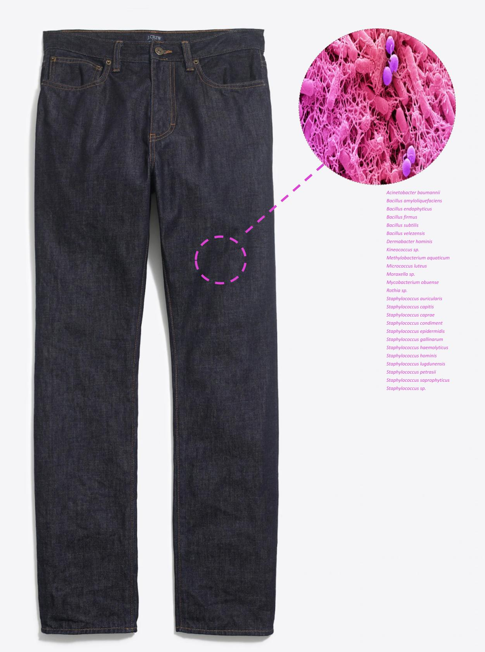
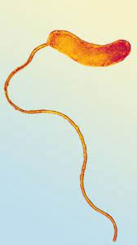
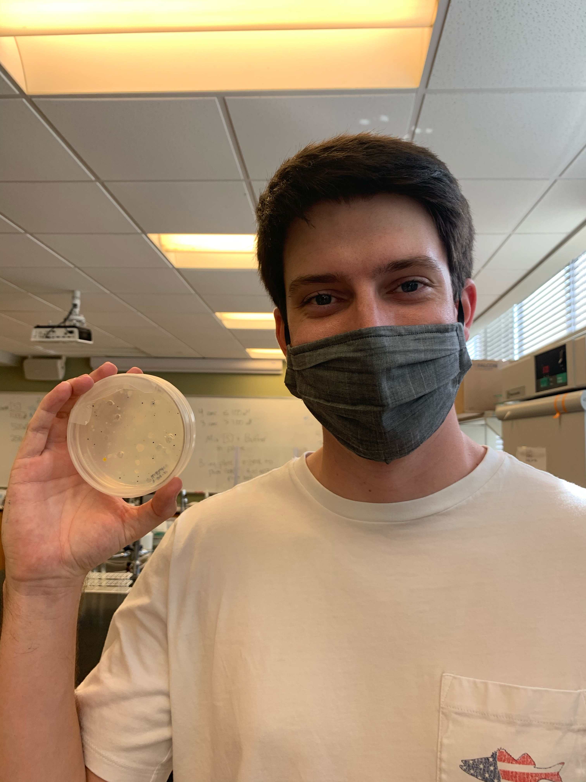
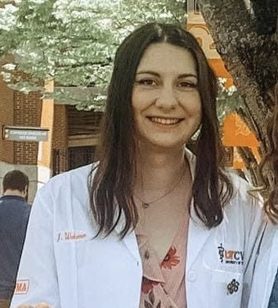
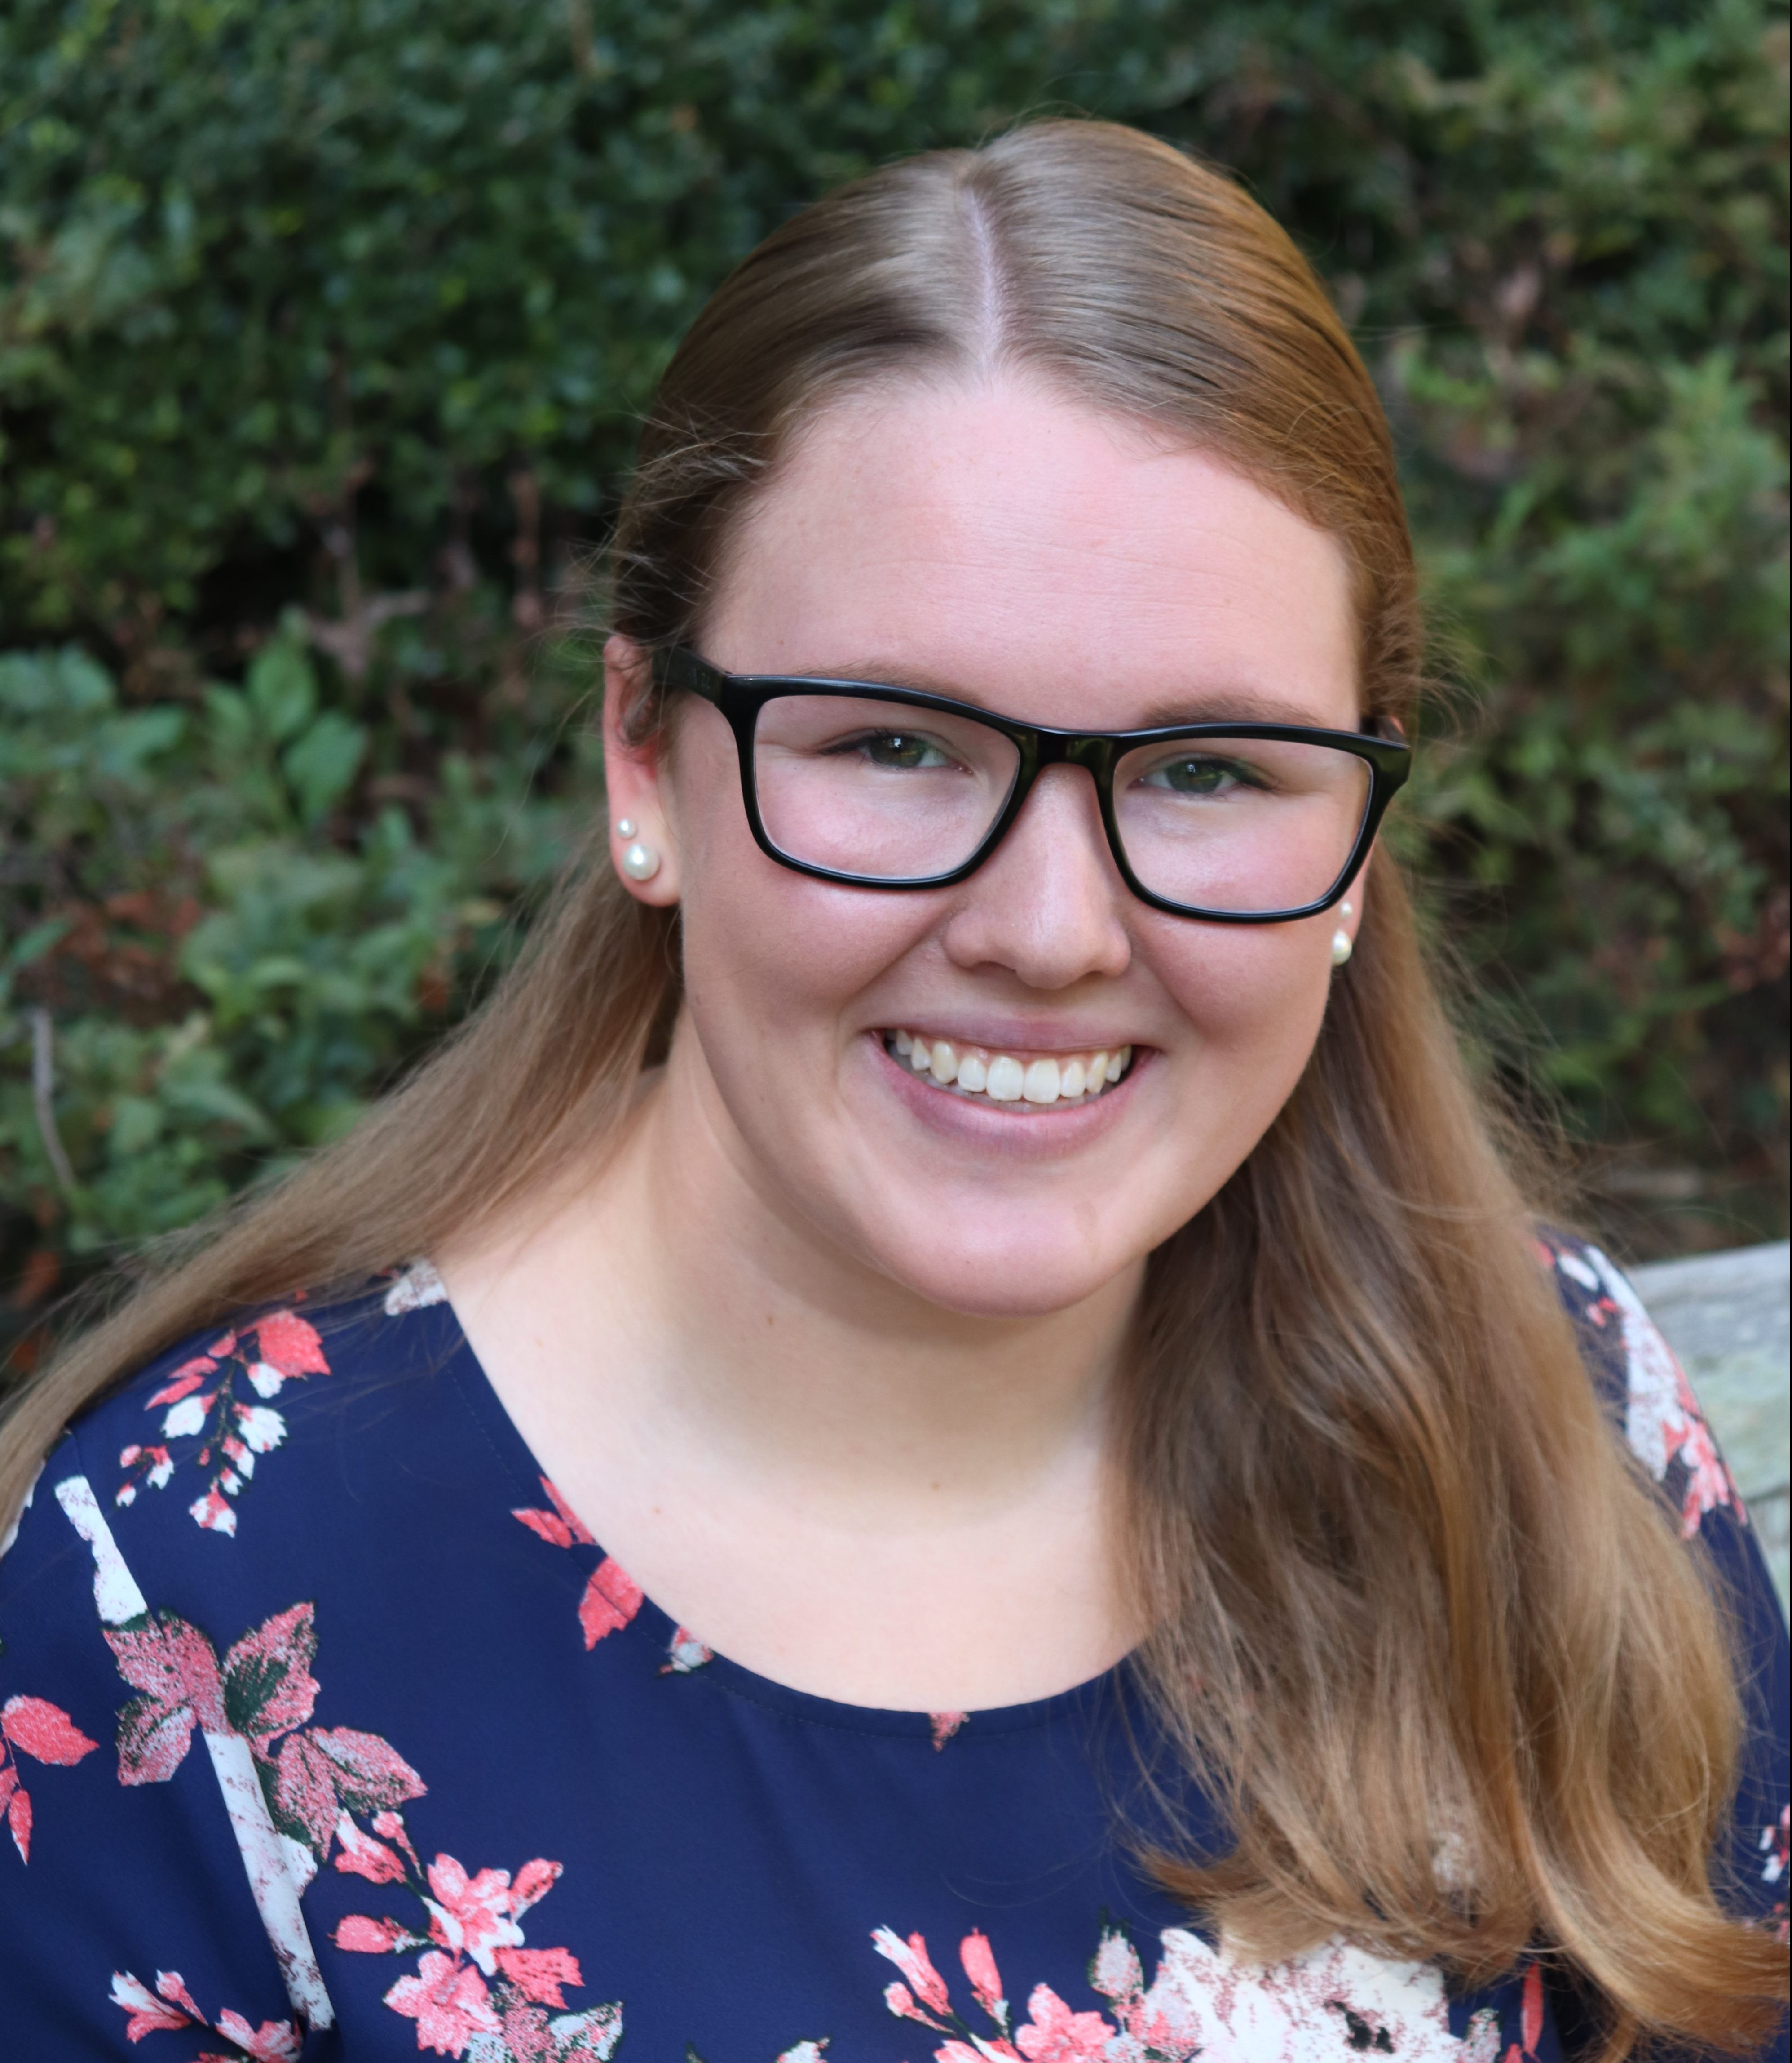
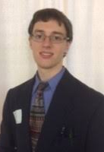
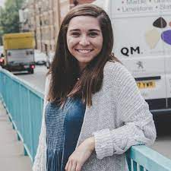
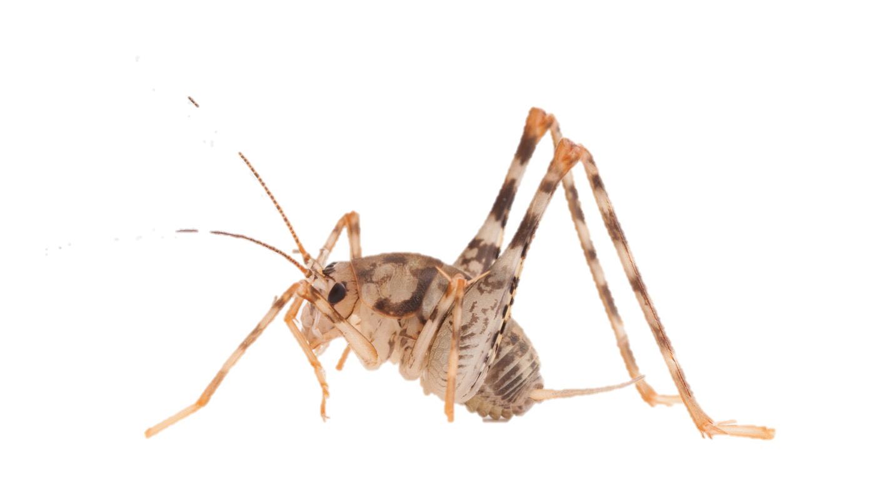
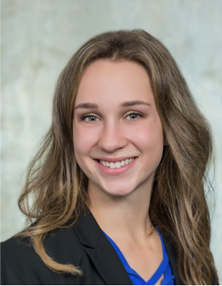
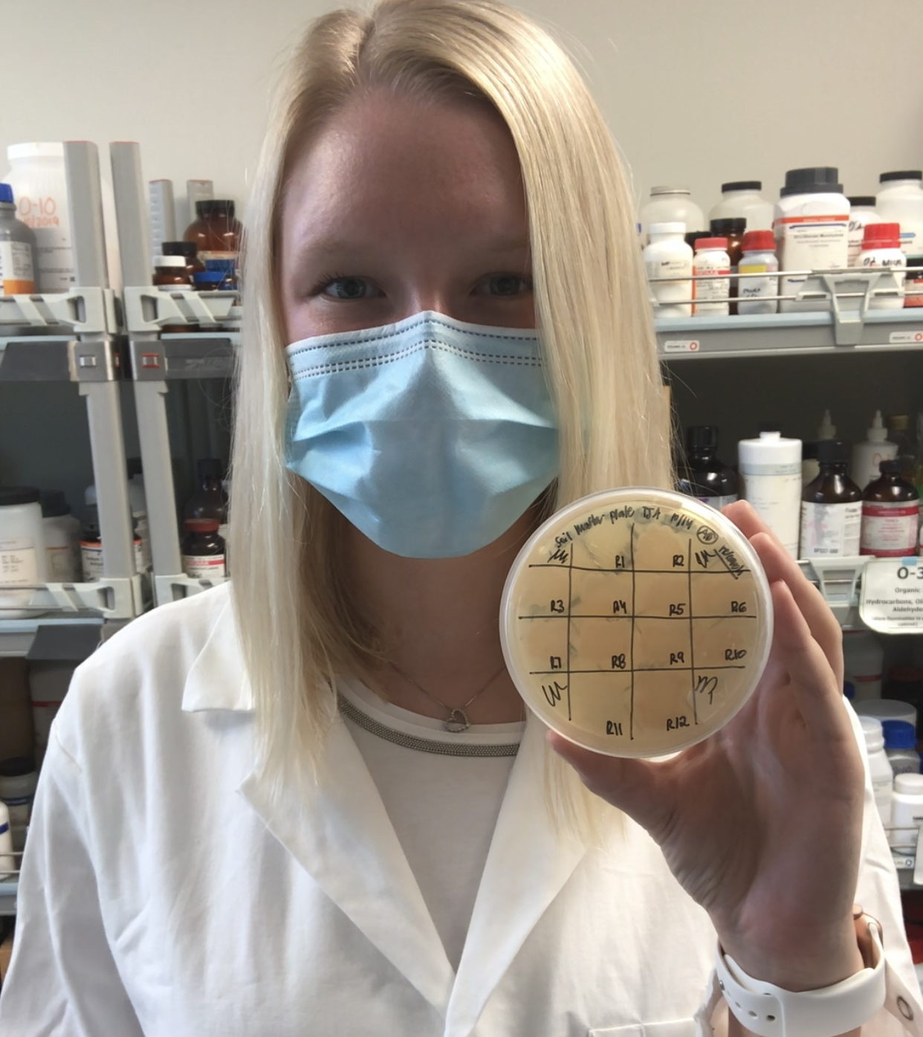
PAST PROJECTS What role do microorganisms have on the world around us?
Clothing
Sourdough
Acinetobacter baumannii
Bacillus amyloliquefaciens
Bacillus endophyticus
Bacillus firmus
Bacillus subtilis
Bacillus velezensis
Dermabacter hominis
Kineococcus sp.
Methylobacterium aquaticum
Micrococcus luteus
Moraxella sp.
Mycobacterium obuense
Rothia sp.
Staphylococcus auricularis S
taphylococcus capitis
Staphylococcus caprae
Staphylococcus condiment
Staphylococcus epidermidis S
taphylococcus gallinarum
Staphylococcus haemolyticus
Staphylococcus hominis
Staphylococcus lugdunensis
Staphylococcus petrasii
Predatory
Bacteria
Food Production
Arthropods
Notes:
Introduction

Slide 15
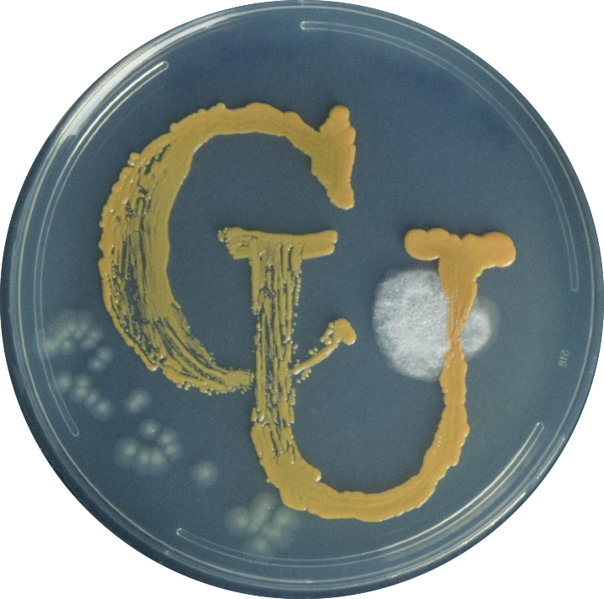
Thank you
Past Student Researchers
Micaela Robson
Kaitlyn Mizelle
Dylan Rogers
Amanda Brechko
William Strader
Caitlyn Vester Coleman
Jessica Wakeman
Jenna Carter
Ashley Darroch Lawson
Taylor Braswell
Biological Sciences Faculty and Staff
Ester H. Howard Summer Research Program
Wiggins Memorial Library Staff
Tiny Earth

